Slide 1
Quick Sort

Slide 2
QuickSort
Pick a “pivot”.
Divide list into two lists:
One less-than-or-equal-to pivot value
One greater than pivot
Sort each sub-problem recursively
Answer is the concatenation of the two solutions

Slide 3
QuickSort: Array-Based Version
Pick pivot:
7 | 2 | 8 | 3 | 5 | 9 | 6
Partition
with cursors
7 | 2 | 8 | 3 | 5 | 9 | 6
<
>
2 goes to
less-than
7 | 2 | 8 | 3 | 5 | 9 | 6
<
>

Slide 4
QuickSort Partition (cont’d)
6, 8 swap
less/greater-than
7 | 2 | 6 | 3 | 5 | 9 | 8
<
>
3,5 less-than
9 greater-than
7 | 2 | 6 | 3 | 5 | 9 | 8
Partition done.
7 | 2 | 6 | 3 | 5 | 9 | 8

Slide 5
QuickSort Partition (cont’d)
Put pivot
into final
position.
5
2
6
3
7
9
8
Recursively
sort each side.
2
3
5
6
7
8
9

Slide 6
Analyzing QuickSort
Picking pivot: constant time
Partitioning: linear time
Recursion: time for sorting left partition (say of size i) + time for right (size N-i-1) + time to combine solutions
T(1) = b
T(N) = T(i) + T(N-i-1) + cN
where i is the number of elements smaller than the pivot
What if input S is sorted, or even mostly sorted?
All the remaining elements would go into either S1 or S2!
Terrible performance!

Slide 7

QuickSort Worst case
Pivot is always smallest element, so i=0:
T(N) = T(i) + T(N-i-1) + cN
T(N) = T(N-1) + cN
= T(N-2) + c(N-1) + cN
= T(N-k) +
= O(N²)

Slide 8
Worst-case Partition Analysis
n
Running time for worst-case partitions at each recursive level:
T(n) = T(n – 1) + T(0) + PartitionTime(n)
= T(n – 1) + Θ(n)
= ∑_{k=1 to n}Θ(k)
= Θ(∑_{k=1 to n} k )
= Θ(n²)
n – 1
n – 2
n
n – 3
2
Recursion tree for
worst-case partition
1

Slide 9
Best-case Partitioning
Size of each subproblem ≤ n/2.
One of the subproblems is of size ⎣n/2⎦
The other is of size ⎡n/2⎤ −1.
Recurrence for running time
T(n) ≤ 2T(n/2) + PartitionTime(n)
= 2T(n/2) + Θ(n)
T(n) = Θ(n lg n)

Slide 10
Recursion Tree for Best-case Partition
cn
cn
cn/2
cn/2
cn
lg n
cn/4
cn/4
cn/4
cn/4
cn
c
c
c
c
c
c
cn
Total : O(n lg n)

Slide 11
Dealing with Slow QuickSorts
Randomly choose pivot
Good theoretically and practically, but call to random number generator can be expensive
Pick pivot cleverly
“Median-of-3” rule takes Median(first, middle, last element elements). Also works well.

Slide 12
Picking the Pivot (contd.)
Example: Median-of-three Partitioning
Let input S = {6, 1, 4, 9, 0, 3, 5, 2, 7, 8}
left=0 and S[left] = 6
right=9 and S[right] = 8
center = (left+right)/2 = 4 and S[center] = 0
Pivot
= Median of S[left], S[right], and S[center]
= median of 6, 8, and 0
= S[left] = 6

Slide 13
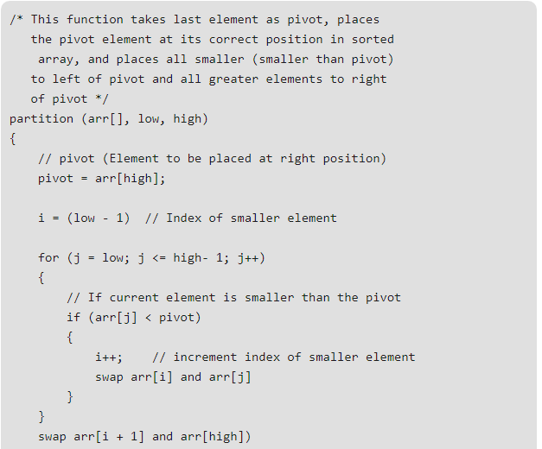
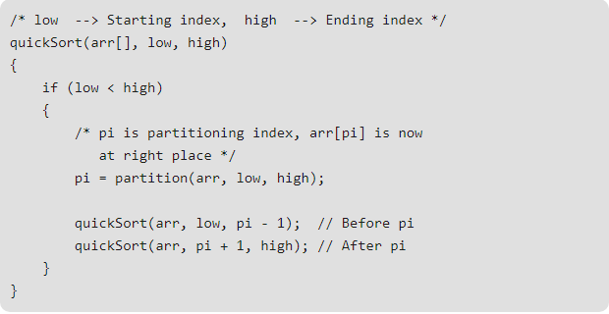
Pseudo code

